Slide 1

2020 Pandemic stock analysis
Presented by NBS: Nabeel / Brick / Sal Thursday July 30, 2020

Slide 2

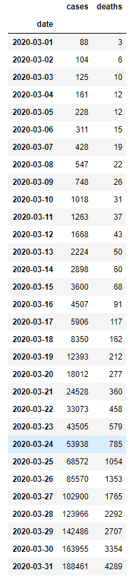
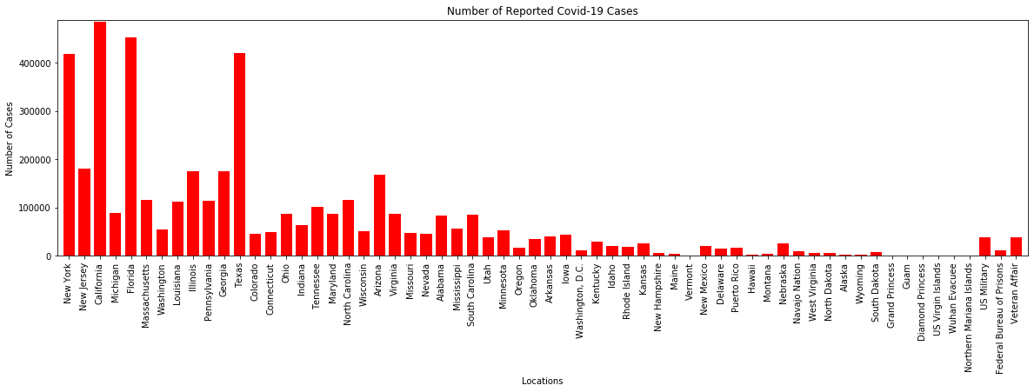
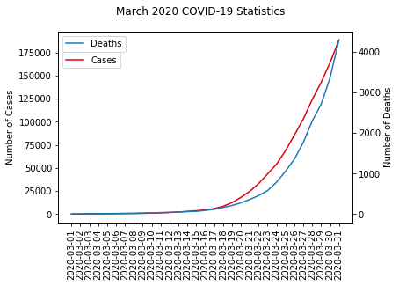
With the growing concern of the ongoing covid-19 pandemic, the fear in the stock market has been growing and continues to be ever present. As you can see from the graph and the # of cases, the concern is valid. Where is the stock going and will it continue to recover as it has oddly done in the past couple months? Nbs is not here to predict where the stock market will be tomorrow, next month, or this time next year. Rather, we are here to show you the current trend of the market in relation to previous epidemics / pandemics

Slide 3
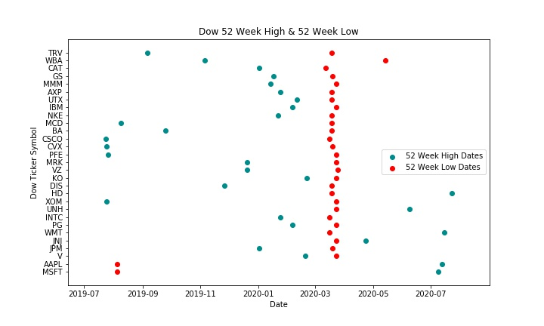
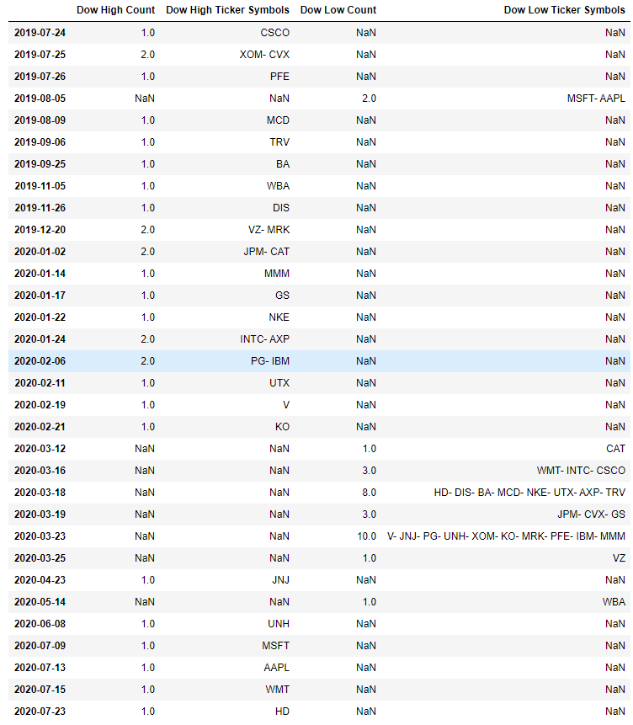
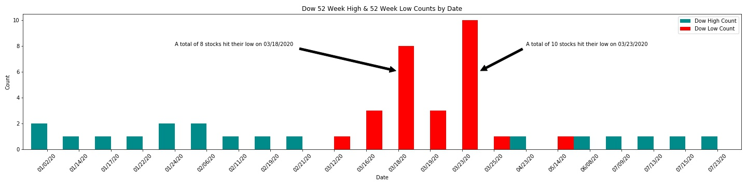
dow 52 Week high and Low data
Filtered / aggregated Data Frame pulled from a Finnhub API
Scatter plot of ticker symbols / dates
Bar graph of counts for 52 Week High/Low by date
Notes:
-First, lets take a look at the data we pulled from our Finnhub API. In this specific request, we were able to get basic information for specific ticker symbols in the Dow Index and get their 52 Week high / low date.
We then grouped and aggregated that data to show how stocks hit their high / low on specific dates. That is what you’re seeing here.
But lets talk about the initial request before we grouped and aggregated it. When we plotted with ticker symbols of this specific index vs. dates. We saw something interesting…
Do you remember Bricks Graph in the previous slide showing the line graph of cases and deaths reported in March? This scatter plot with ticker symbols shows all the stocks that hit their 52 Week lows in March in Red
Also, you will see that some of these stocks hit there 52 Week High just before march and also after in Green
-I understand that in the scatter plot you’re not seeing actual values in the y-Axis. However, we wanted to visually show you how almost all the stocks in this index hit there 52 week low around the same time…. In March when Covid-19 first impacted the US.
Now lets get back to the aggregated data…
This bar graph shows the counts of stocks in the Dow that hit their 52 Week High in Green / 52 Week low in Red by date.
Annotations have been provided to draw more attention to specific dates in which a high # of stocks hit their 52 Week low

Slide 4
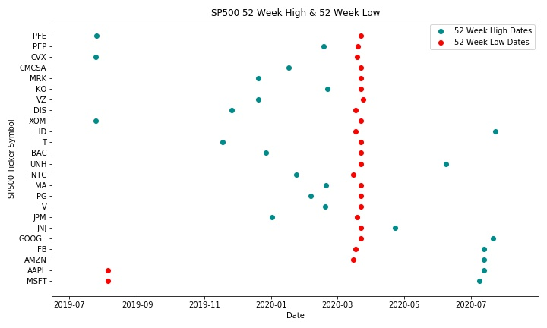
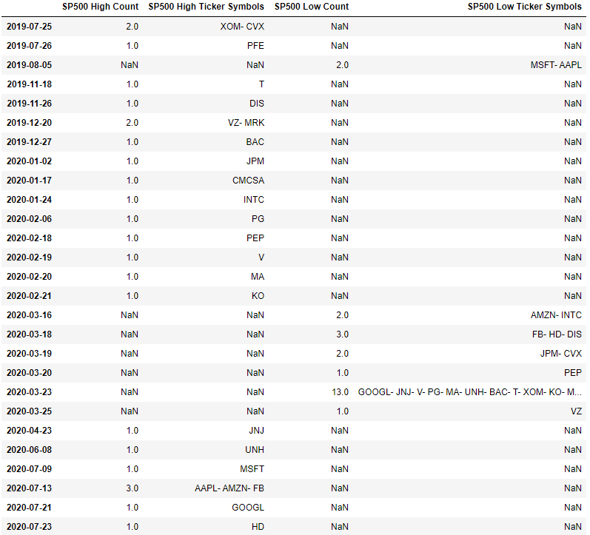
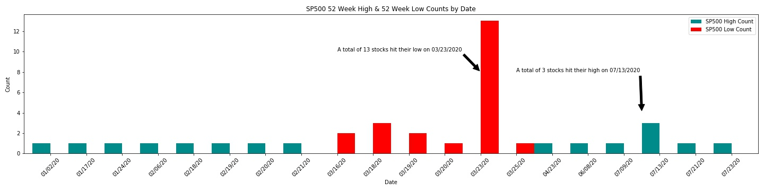
sp500 52 Week high and Low data
Filtered / aggregated Data Frame pulled from a Finnhub API
Scatter plot of ticker symbols / dates
Bar graph of counts for 52 Week High/Low by date

Slide 5
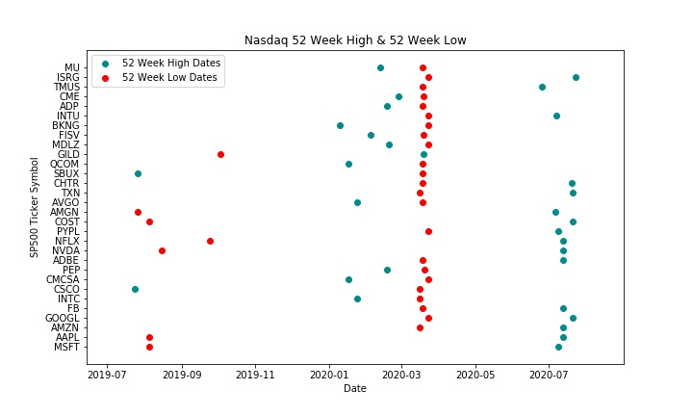
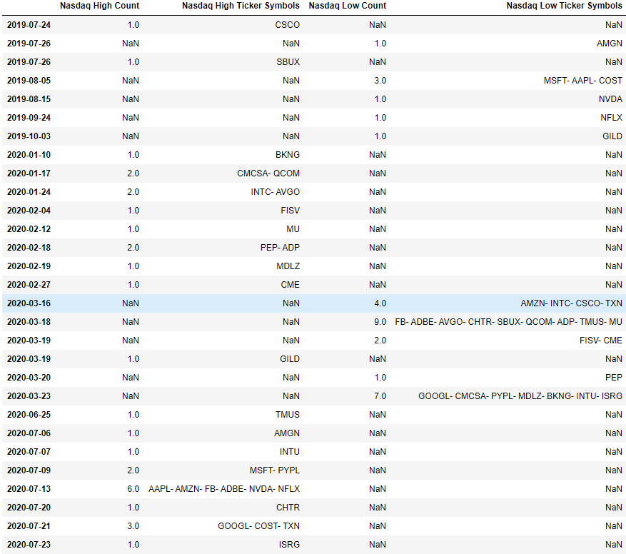
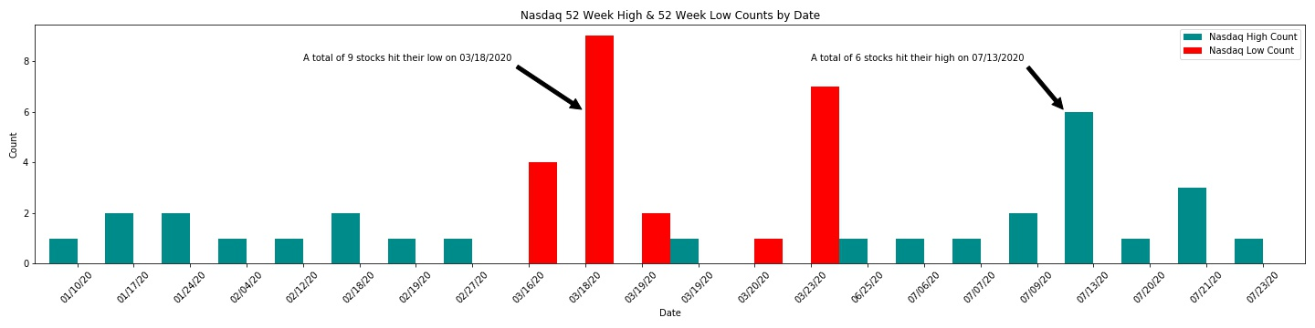
nasdaq 52 Week high and Low data
Filtered / aggregated Data Frame pulled from a Finnhub API
Scatter plot of ticker symbols / dates
Bar graph of counts for 52 Week High/Low by date

Slide 6

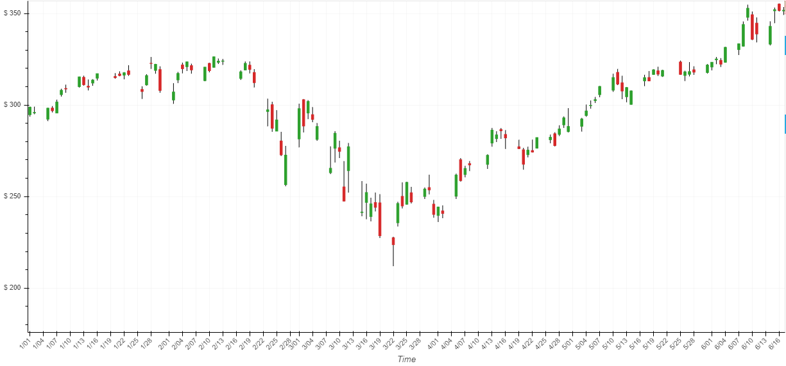
Now Let’s take look at 1 major stock (Apple) and how it has performed in 2020

Slide 7
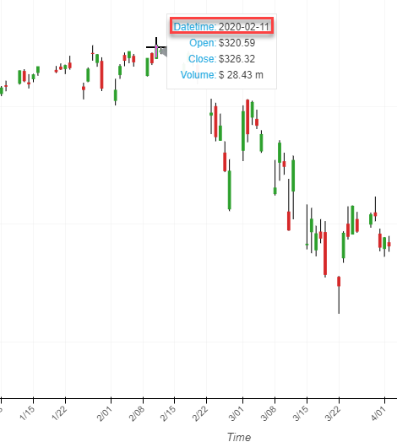
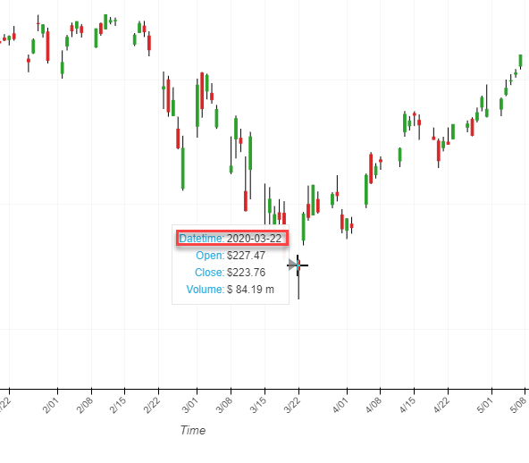
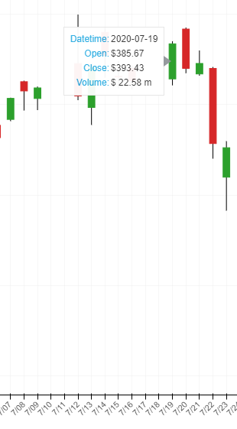
Apple stock during ytd 2020

Slide 8
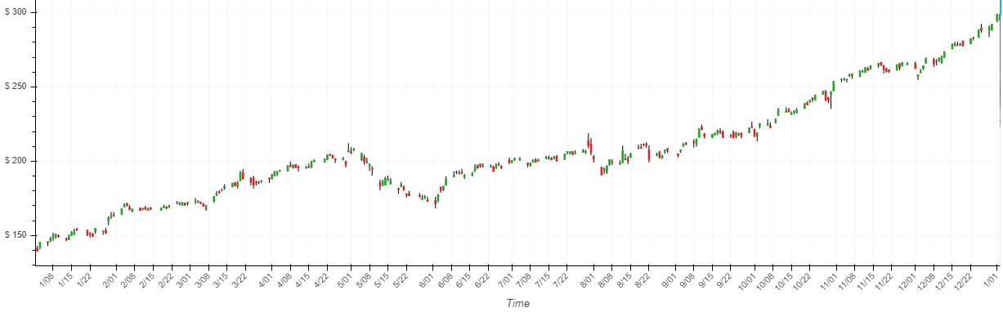
Apple stock during 2019

Slide 9
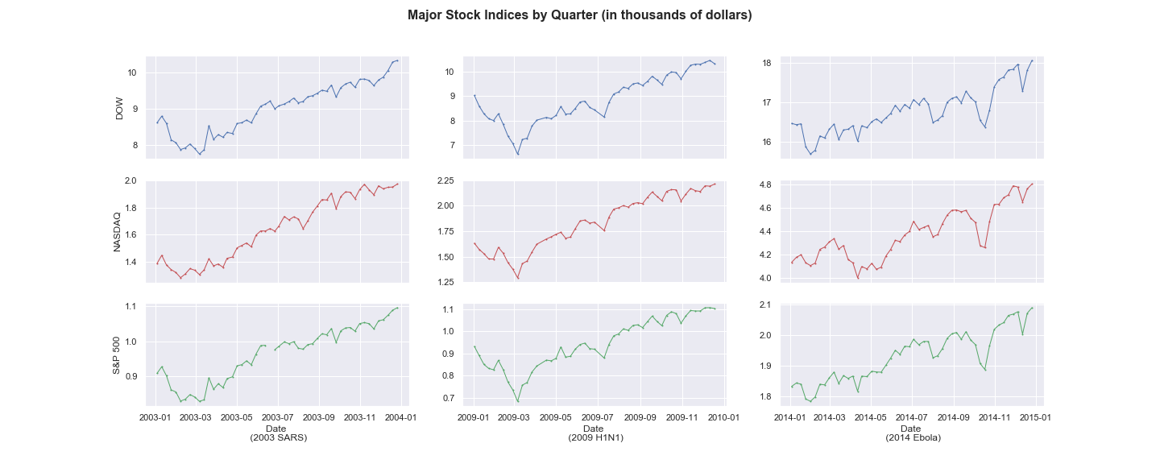
Ready for the big picture?
Let’s look at some timeseries of a few of the biggest pandemics / epidemics that have had an impact on the major stock market indices

Slide 10
Difficulties Faced and Lessons Learned
One of the challenges we faced was determining the most effective way to explain our data to show how this current pandemic relates to ones in the past.
After presenting and realizing there are some major differences between this current pandemic and the ones we discussed, Such as our economy shutting down, We could have factored that into the presentation in some way.
We would have loved to have been able to pull more recent data as it relates to the # of cases of covid-19.
In doing so, we could have shown how the cases as covid-19 have continued to rise and how the stock market continues to show recovery.

Slide 11
In closing... We just want to reiterate that we are in no way predicting the future of the stock market current day. We hope that with the data we extracted and pulled form CSV files and API’s that we were able to show you that historically the stock market recovers from pandemics and epidemics similar to the one we are all experiencing today. Thank you all for your time and attention!

Slide 12

Questions??

